Slide 2
Respecting your Investments:
How to Leverage your Existing Code in a New Windows Runtime LOB App
2-515
Harry Pierson
harry.pierson@microsoft.com
@devhawk
Senior Development Engineer, Windows

Slide 3

Your workforce has to become
more mobile to stay effective.

Slide 4
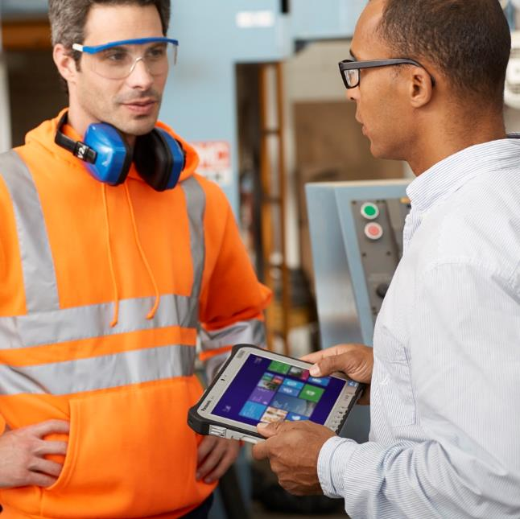
You need to empower your employees with touch-first
Line of Business apps.

Slide 5

You can’t afford to rewrite all your existing LOB app code from scratch.

Slide 6
Windows 8.1 Update 1 lets you leverage existing LOB app code while taking advantage of new tablet form factors.

Slide 7

Agenda
Policy change for side-loaded Windows Runtime apps
Using network loopback for
inter-process communication
Leveraging existing managed code with Brokered Windows Runtime Components

Slide 8
Side-loaded Windows Runtime apps may now communicate with other processes running on the system.

Slide 9
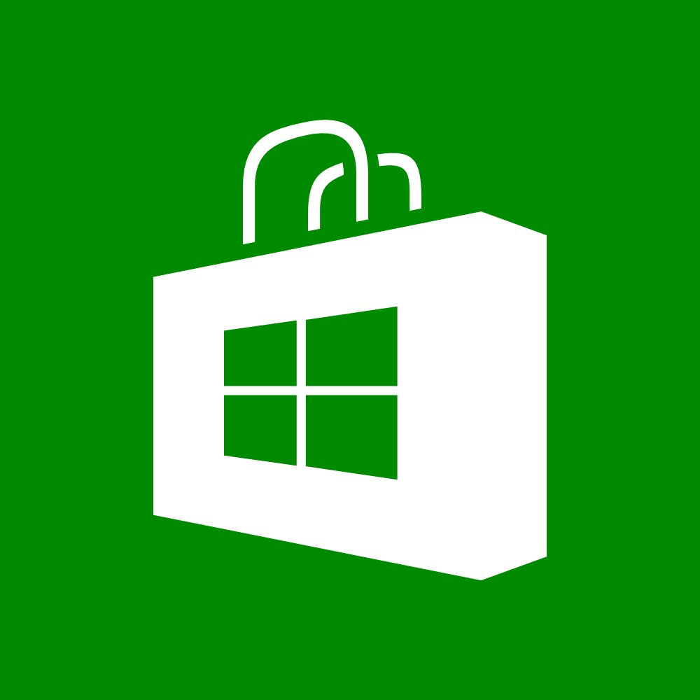
Windows 8 introduced a new confidence model for Windows Store apps.

Slide 10
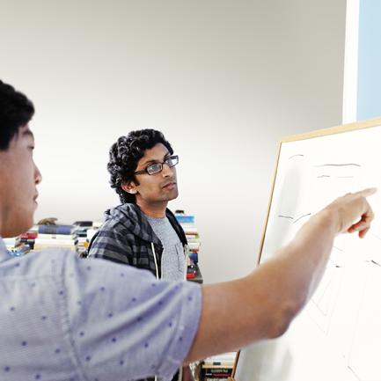
Enterprises need the flexibility to trade confidence for capability.

Slide 11

Inter-process communication policy now only applies to apps deployed via the Windows Store.
There is no longer a restriction on inter-process communication for side-loaded Windows Runtime apps.

Slide 12
Use network loopback for inter-process communication.

Slide 13
The firewall that isolates WinRT apps from the loopback adapter can be disabled to enable inter-process communication.

Slide 14
Firewall isolates Windows Runtime apps
Network endpoint
Windows Store
app process
Local service application

Slide 15
Admins can disable the firewall
Network endpoint
Windows Store
app process
Local service application
Windows Firewall
Side Loaded “Modern”
app process
Network
Endpoint
Local Service Application

Slide 16
Mechanisms to disable the firewall
CheckNetIsolation.exe
NetworkIsolationSetAppContainerConfig function
loopback.codeplex.com

Slide 17
Demos
CheckNetIsolation.exe
Inter-process Communication via WCF
Inter-process Communication with ASP.NET Web API & SignalR

Slide 18
Access the full power of Windows from using Brokered WinRT Components.

Slide 19
Brokered WinRT Components get activated in a separate process outside of app container.

Slide 20
WinRT Components in Desktop Process
System provided dllhost.exe
clrhost.dll
new NWindRT.DAL
.Connection();
MyAssembly.winmd
Standard WinRT Marshaling
OOPWinRT
Class
Side Loaded WinRT app
RoActivateInstance

Slide 21
Brokered WinRT components require a globally registered proxy/stub for cross process communication.

Slide 22
Activatable brokered WinRT components have to be registered manually in the appx manifest.

Slide 23
.AppXManifest Declaration
<Extension Category="windows.activatableClass.inProcessServer">
<InProcessServer>
<Path>clrhost.dll</Path>
<ActivatableClass ActivatableClassId="NWindRt.DAL.Connection"
ThreadingModel="both">
<ActivatableClassAttribute Name="DesktopApplicationPath"
Type="string"
Value="%ProgramFiles%\NWindRt"/>
</ActivatableClass>
</InProcessServer>
</Extension>

Slide 24
Demo
Accessing a SQL Compact database via Brokered WinRT Components

Slide 25
Network Loopback vs. Brokered WinRT
Works on Win 8 and 8.1
WCF or REST based programming model
Requires service process to be always running
Network callbacks don’t activate suspended apps
Requires Update 1
WinRT based programming model
Loads components on demand
Supports callbacks that activate suspended apps

Slide 26
Windows 8.1 Update 1 lets you leverage existing code while taking advantage of new tablet form factors.

Slide 27
Side-loaded Windows Runtime apps may communicate with other processes.
Use network loopback for inter-process communication.
Use brokered WinRT components to access the full power of Windows.

Slide 28
Additional resources
2-524: Deploying and Managing Enterprise Apps
  1:00PM Thursday, Room 2022
White Papers
  Windows 8.1 Enterprise Feature Guide
  Using network loopback in side-loaded Windows Store apps white paper
  Brokered Windows RT components for side-loaded Windows Store apps
Samples
  http://go.microsoft.com/fwlink/?LinkId=393654
  http://go.microsoft.com/fwlink/?LinkId=393655

Slide 29
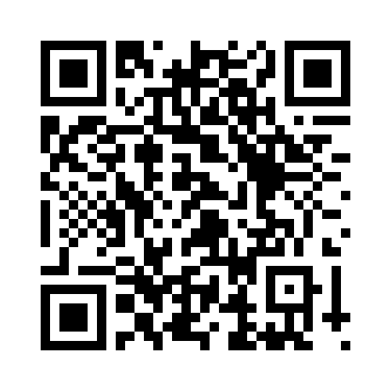
Your Feedback is Important
Fill out an evaluation of this session
and help shape future events.
Scan the QR code to evaluate
this session on your mobile device.
You’ll also be entered into
a daily prize drawing!

Slide 30

© 2014 Microsoft Corporation. All rights reserved. Microsoft, Windows, Windows Vista and other product names are or may be registered trademarks and/or trademarks in the U.S. and/or other countries.
The information herein is for informational purposes only and represents the current view of Microsoft Corporation as of the date of this presentation. Because Microsoft must respond to changing market conditions, it should not be interpreted to be a commitment on the part of Microsoft, and Microsoft cannot guarantee the accuracy of any information provided after the date of this presentation. MICROSOFT MAKES NO WARRANTIES, EXPRESS, IMPLIED OR STATUTORY, AS TO THE INFORMATION IN THIS PRESENTATION.

